Slide 1

SQL ONLINE BOOK STORE PROJECT
Analyzed availability of total stock.
Remaining stock after fulfilling all orders.
All genres of books available.
Book sales, and order trends by customers and many more by using SQL.

Slide 2
SQL: The Backbone for Data Analysts
Data Access & Querying SQL lets analysts retrieve specific data quickly from large databases.
Data Aggregation & Reporting Easily summarize metrics using functions like SUM(), AVG(), GROUP BY.
Combining Multiple Data Sources Join multiple tables using JOIN to create meaningful insights.
Data Cleaning & Transformation Perform filtering, sorting, and transformation of data with clauses like WHERE, CASE, ORDER BY.
Foundation for Advanced Tools Powers BI tools like Tableau, Power BI, Excel – often SQL is the source layer.

Slide 3
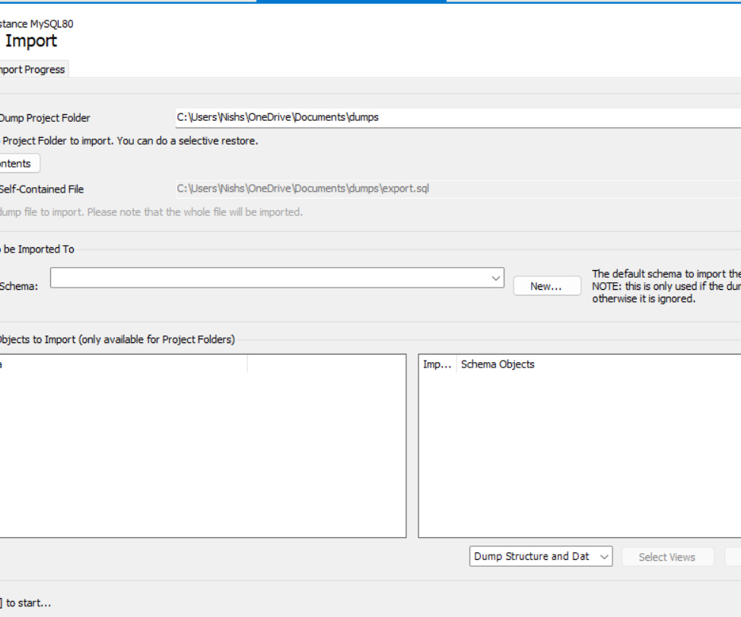
Steps to create this project:-
1.Imports all the Excel files (.csv) to MySQL workbench
Open MySQL workbench > Select new Query tab > go and select server option > Click on Data Import.
You will get a new window like this:-

Slide 4
Steps to create this project:-
2. Select import from self contained file and browse your files.
3. Create a new Database and use it.
4. Check all the data once at MS – Excel in case any null values there. (Optional)
5. Once everything done come to MySQL workbench and start writing queries and get output.

Slide 5
DATASETS:-
Get Dataset from mine Github profile
iNish27/Online-Book-Store: This is another SQL project.
Check my Project on LinkedIn
https://www.linkedin.com/in/nishant-sharma-0141ba360/

Slide 6
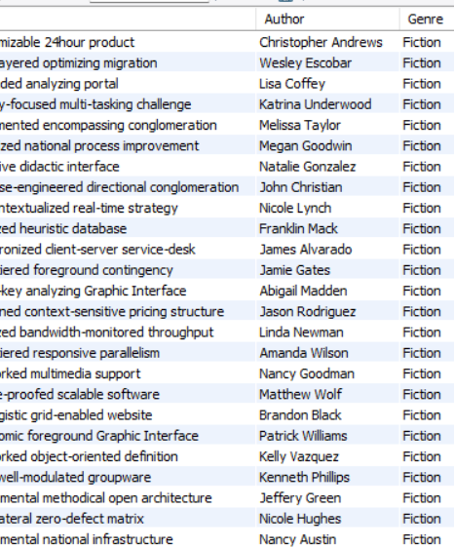
Retrieve all books in the "Fiction" genre
Select * from books where Genre = 'Fiction';

Slide 7
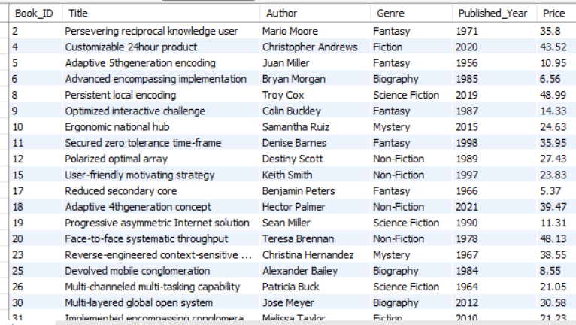
Find books published after the year 1950:
Select * from books where Published_Year > 1950;

Slide 8
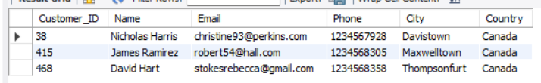
List all customers from the Canada:
Select * from customers where Country = 'Canada';

Slide 9
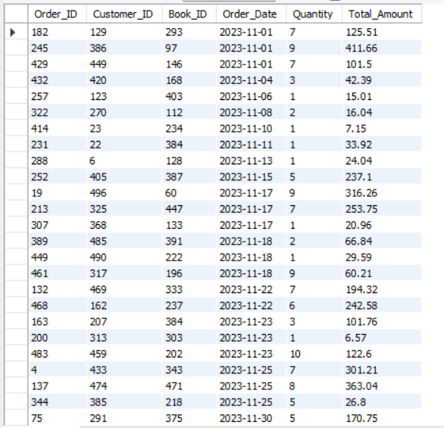
Show orders placed in November 2023:
Select * from Orderswhere Order_Date between '2023-11-01' and '2023-11-30’
order by Order_Date ASC;

Slide 10

Retrieve the total stock of books available:
Select sum(Stock) as Total_Stock from books;

Slide 11
Find the details of the most expensive book:
Select * from books order by Price DESC Limit 1;

Slide 12
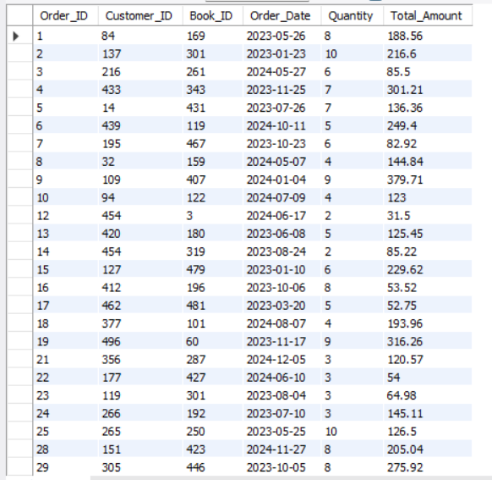
Show all customers who ordered more than 1 quantity of a book:
Select * from Orders where Quantity > 1;

Slide 13
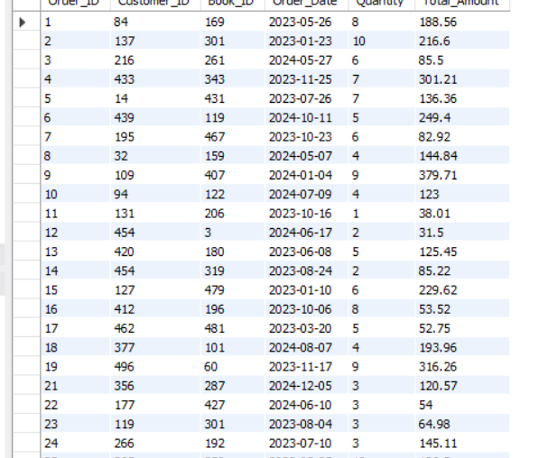
Retrieve all orders where the total amount exceeds $20:
Select * from orders where Total_Amount > 20;

Slide 14
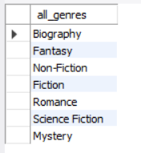
List all genres available in the Books table:
Select distinct(Genre) as all_genres from books;

Slide 15

Find the book with the lowest stock:
Select * from books order by Stock ASC Limit 1;

Slide 16

Calculate the total revenue generated from all orders:
Select sum(Total_Amount) as Total_Revenue from orders;

Slide 17
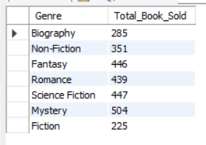
Retrieve the total number of books sold for each genre:
Select books.Genre, sum(orders.Quantity) as Total_Book_Sold from books inner join orders on books.Book_ID = orders.Book_ID group by books.Genre;

Slide 18

Find the average price of books in the "Fantasy" genre:
Select avg(Price) as Average_Price from books Where Genre = 'Fantasy';

Slide 19
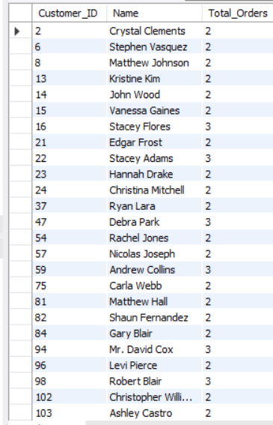
List customers who have placed at least 2 orders:
Select Customers.Customer_ID, Customers.Name, count(Order_ID) as Total_Orders from Customers join Orders on Customers.Customer_ID = Orders.Customer_ID Group by Customers.Customer_ID, Customers.Name Having count(order_ID) >= 2;

Slide 20

Find the most frequently ordered book:
Select count(O.Order_ID) as Order_Count, b.Title, o.book_ID from orders o join books b on o.Book_ID = b.Book_ID Group by o.book_ID, b.Titleorder by Order_Count Desc limit 1;

Slide 21
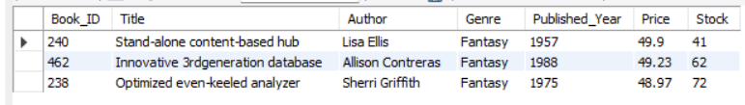
Show the top 3 most expensive books of 'Fantasy' Genre :
Select * from books Where genre = 'Fantasy’ order by Price DESC Limit 3;

Slide 22
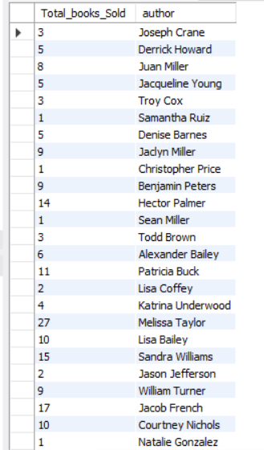
Retrieve the total quantity of books sold by each author:
Select sum(o.Quantity) as Total_books_Sold, b.author from books b join orders o
on b.book_ID = o.book_ID group by b.author;

Slide 23
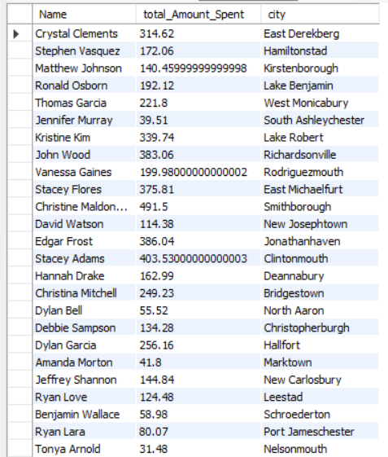
List the cities where customers who spent over $30 are located:
Select c.Name, sum(o.Total_Amount) as total_Amount_Spent, c.city from customers c join orders o onc.customer_ID = o.customer_ID Group by c.name, c.city having sum(o.Total_Amount) > 30;

Slide 24

Find the customer who spent the most on orders:
Select c.Name, c.Customer_ID, sum(o.Total_Amount) as Total_Spent from customers c join orders o on c.Customer_ID = o.Customer_ID group by c.Name, c.Customer_ID Order by Total_Spent DESC Limit 1;

Slide 25
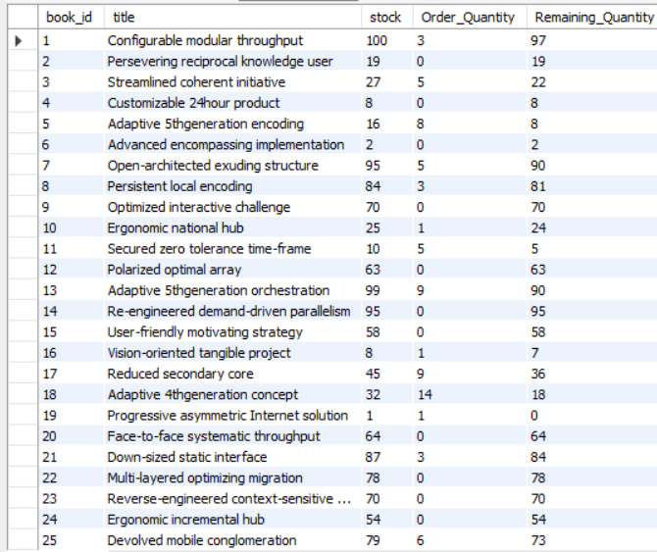
Calculate the stock remaining after fulfilling all orders:
SELECT b.book_id, b.title, b.stock, COALESCE(SUM(o.quantity), 0) AS Order_Quantity, b.stock - COALESCE(SUM(o.quantity), 0) AS Remaining_Quantity FROM books b LEFT JOIN orders o ON b.book_id = o.book_id GROUP BY b.book_id, b.title, b.stock ORDER BY b.book_id;

